Slide 1
— Lectorial 4 Chapter 1
Machine Learning @ RMIT

Slide 2
Data Set
Information
Noise
Information is the useful
part of the data set that we
want to capture for model building
Noise(or randomness) is the unwanted
and useless part of the data we do not want,
and must eliminate as much as possible

Slide 3

ID | Occupation | Age | Loan-Salary Ration | Outcome
1 | Industrial | 34 | 2.96 | repaid
2 | Professional | 41 | 4.64 | default
3 | Professional | 36 | 3.22 | default
4 | Professional | 41 | 3.11 | default
5 | Industrial | 48 | 3.80 | default
6 | Industrial | 61 | 2.52 | repaid
X Train set

Slide 4
After we give the X –Train and Y-Train set to the analyst and he ‘learns’ from it, then we give him only the X -Test for him to predict the Outcome for that set.
ID | Occupation | Age | Loan-Salary Ration | Prediction
7 | Professional | 37 | 1.50 | repaid
8 | Professional | 40 | 1.93 | default
9 | Industrial | 33 | 5.25 | default
X Test set

Slide 5
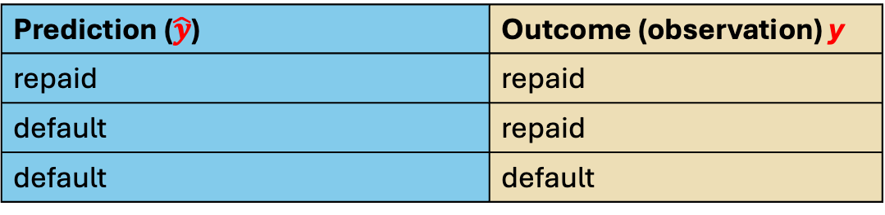
Prediction ($\hat{y}$) | Outcome (observation) y
repaid | repaid
default | repaid
default | default
Now we can evaluate the the accuracy of the predictions from the Analyst.
There are metrics that we can use for this evaluation.

Slide 6
ID | Occupation | Age | Loan-Salary Ration | Outcome
1 | Industrial | 34 | 2.96 | repaid
2 | Professional | 41 | 4.64 | default
3 | Professional | 36 | 3.22 | default
4 | Professional | 41 | 3.11 | default
5 | Industrial | 48 | 3.80 | default
6 | Industrial | 61 | 2.52 | repaid
7 | Professional | 37 | 1.50 | repaid
8 | Professional | 40 | 1.93 | repaid
9 | Industrial | 33 | 5.25 | default
Y Train set
X Train set
X Test set
Y Test set

Slide 7
The goal of predictive modeling is to develop a model that makes accurate predictions on new data, unseen during training.

Slide 8
If a model you build can perform well on the training data, but perform
poorly in the test data, then that model is not a good model for your data.
We need a model that performs well in both the train and the test sets

Slide 9
-------- Fitted model

Slide 10
High Bias Error
Underfit
Low Bias Error
Overfit
What is a bias error : it is the error that occurs due to your model being too simple
thereby not capture the true relationship in the data

Slide 11
High Bias Error
Underfit
Your complicated model here performs
perfect on the training data (blue triangles),
However, if we bring in new data points (test set)
we can see that our complicated model does not work
very well with the test data.

Slide 12
High Bias Error
Underfit
The model does not
perform well with the training
data.
Low Bias Error
High Variance
Overfit
The model fits very well with the
training data, but does not perform
well with the test data.
So, variance occurs when your model is too
sensitive to even small changes in the data.

Slide 13


Example from computer vision:

Slide 14

The model has learned from irrelevant features of the data, and focused on noise rather than the real data.
This is also called overfitting.

Slide 15
There is some error, so not a perfect fit

Slide 16
There is some error for the test data too, just like the error we made for the test data
in the more complicated model we fit (figure 2), however, these errors will now be smaller.

Slide 17
Low Bias Error
High Variance
Overfit
High Bias Error
Underfit
Low Bias, low variance model

Slide 18
Total Error
= Bias error + Variance error
Error
Variance
Bias
Model Complexity
A complex model attempts to fit all of the training data points into the model.
This becomes a problem later on when that model cannot be generalized to other new data (test data).
Total Error: The sum of the bias error and variance error.

Slide 19
Total Error
= Bias error + Variance error
Error
Variance
Trade-off point
Bias
Model Complexity

Slide 20
Causes of Bias error (underfit)
Model too simple
Insufficient relevant descriptive
features
Causes of Variance error (Overfit)
Model too complex
Redundant and noisy descriptive features
Insufficient training data
Data Leakage
Example:
Consider the case where you are
attempting to predict default/repay
outcomes for applications for a loan
from a bank.
You have the following descriptive features:
ages, incomes, previous loan history, number
of dependents, loan-to-salary ratio etc.
You decide only to use the incomes
of the applicants to build your model, and ignore
all other ‘would be “ useful descriptive features.

Slide 21
Cause and Remedies for Bias error (underfit)
Model too simple:
Fit more complex models
2. Insufficient relevant descriptive
features
Add more features to your model, feature
engineering
Causes of Variance error (Overfit)
Model too complex
Regularization, tuning
2. Redundant and noisy descriptive features
Feature elimination
3. Insufficient training data
Increase the training data
Data Leakage

Slide 22
Acknowledgements:
https://www.youtube.com/watch?v=bM6jcoyK2ps

